Slide 1
What does ______ mean?
Working with Windows

Slide 2
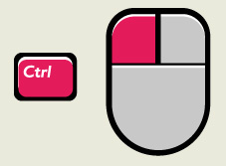
Click vs. Right Click
Context-sensitive menu

Slide 3
Keyboard Shortcuts
Understanding the keyboard can save you lots of time as you work.
It’s much faster to use a shortcut than the mouse.

Slide 4
Popular Shortcuts
CTRL +C = Copy
CTRL +X = Cut
CTRL +V = Paste
CTRL +A = Select All
CTRL +Z = Undo
CTRL +Y = Redo
CTRL +S = Save
CTRL +P = Print
Windows +D =Desktop
ALT +Tab = Switch Programs
CTRL +ALT+DEL= Force Quit
ALT + F4= Shutdown current program

Slide 5
Print Screen / prt scn

Slide 6
Start Menu

Slide 7
All Programs

Slide 8
Computer / My Computer

Slide 9
Search
Quick scavenger hunt
Movie (.mov, .wmv, .mp4)
Song (.mp3, .wma)
Picture (.jpg, .jpeg, .gif, .png)

Slide 10
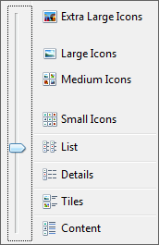
Changing Views

Slide 11
Task Bar

Slide 12
Control Panel

Slide 13
Programs and Features: Uninstall a program

